Slide 1
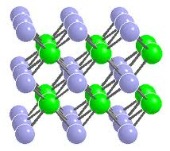
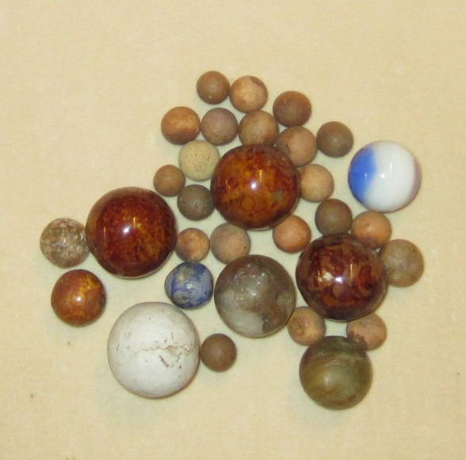
Ionic materials (Transferred Electron)
In ionic materials, different considerations can be important (electrostatics, different size of ions)
Figure shows the crystal structure of Cs⁺Cl⁻. The lattice constant a is 4.12 Å and all the bonds shown have the same length. The grey atoms are Cs and the green ones are Cl.
Group: Define crystal structure: meaning what are the primitive Bravais lattice and the associated basis for this crystal (including the locations of these atoms in terms of lattice parameter a)?
a
Notes:
What is the angle between the chemical bonds?
(1V3) simple cubic with two atom basis: (0 0 0) and (½ ½ ½). Need to identify which atom is at which. Though, it doesn’t matter which you pick, as you could do either, but a full definition of the crystal structure defines the lattice vectors, the atoms positions and atom types.

Slide 2
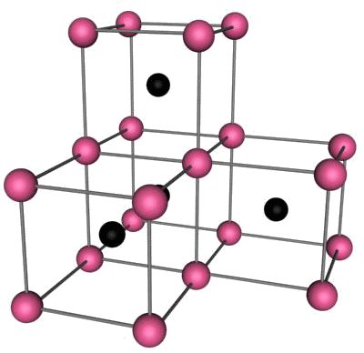
Cesium Chloride Structure Cs⁺Cl⁻
Simple cubic lattice with a basis consisting of a cesium ion at the origin 0 and a chlorine ion at the cube center
CsBr and CsI crystallize in this structure. The lattice constants are in the order of 4 angstroms.

Slide 3
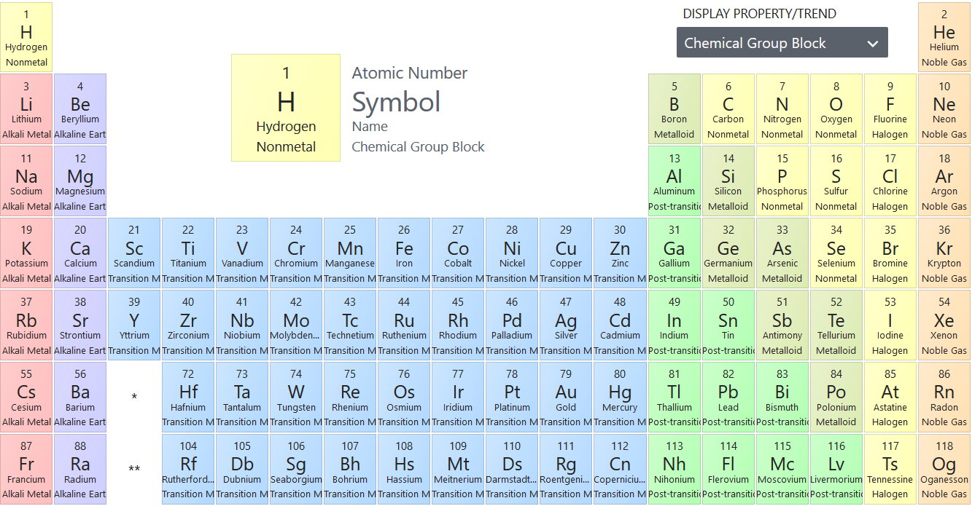
Ionic Bonding
Elemental Na (atomic # 11) or Cs (#55) would be metallic, but you can change that if brought in contact with an electronegative element (e.g. Cl, 17)
What are the electronic configurations of Na & Cl?
Notes:
Figure on page 9 of Holgate

Slide 4
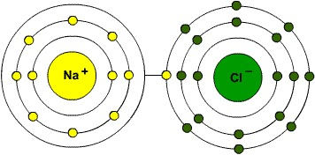
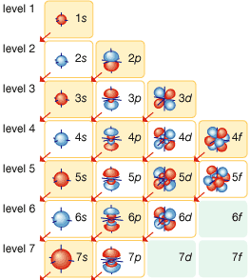
Ionic Bonding
Elemental Na (atomic # 11) or Cs (#55) would be metallic, but you can change that if brought in contact with an electronegative element (e.g. Cl, 17)
What are the electronic configurations of Na & Cl?
Anion = Negative ion (atom with extra electrons)
Cation = Positive ion (atom missing electrons)
Which type of ions are Na and Cl?
Notes:
Figure on page 9 of Holgate

Slide 5
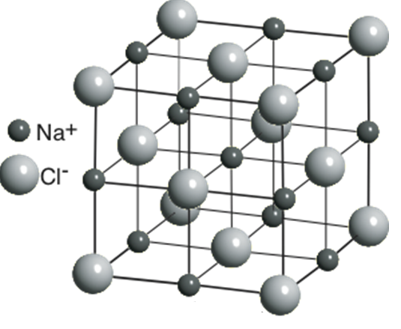
NaCl (Salt) Structure
In NaCl the small Na are in interstitial positions between the Cl ions
Group: Define the crystal structure
Cs⁺Cl⁻
For comparison
Notes:
The negative ions are in general much bigger than the positive ions because of the smaller nuclear charge.
So the positive ions can be fit into a close-packed lattice of negative ions as an interstitial alloy.
Can you see the fcc crystal / two fcc into each other?

Slide 6
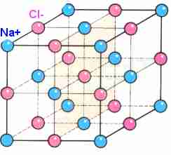
Simple Crystal Structures NaCl
NaCl: interpenetrating fcc structures
One atom at (0,0,0)
Second atom displaced by (1/2,0,0)
NaCl

Slide 7
Why do these two different ionic structures have very different crystal structures?
Notes:
NaCl=6, CsCl=8

Slide 8
Why do these two different ionic structures have very different crystal structures?
How many nearest neighbors (NN) does each have?
Notes:
NaCl=6, CsCl=8

Slide 9
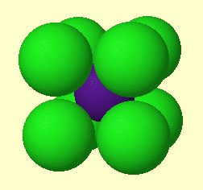
Simple Crystal Structures NaCl
Majority of ionic crystals prefer NaCl structure despite lower coordination (fewer NN)
Radius of cations much smaller than anions typically (removed e⁻s)
For very small cations, anions can not get too close in the other typical structure (CsCl)
This favors NaCl structure where anion contact does not limit structure as much
CsCl

Slide 10
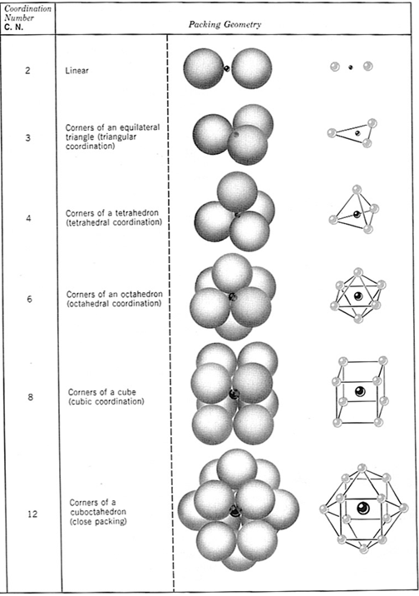
Can predict number of nearest neighbors in ionic systems
Coordination number is just the # of nearest neighbors of an ion
It varies based on the type of bonding and the size of the ions.
Let’s determine the expected CN for NaCl
Notes:
Kittel doesn’t really talk about this here, but Holgate does. If you have two different types of atoms, you can predict the structure based on their size difference.

Slide 11
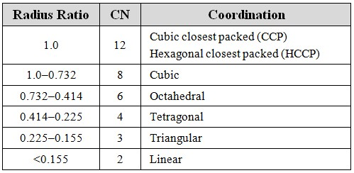
Can predict number of nearest neighbors in ionic systems
Coordination number is just the # of nearest neighbors of an ion
It varies based on the type of bonding and the size of the ions.
Let’s determine the expected CN for NaCl
Expected
Notes:
Kittel doesn’t really talk about this here, but Holgate does. If you have two different types of atoms, you can predict the structure based on their size difference.

Slide 12
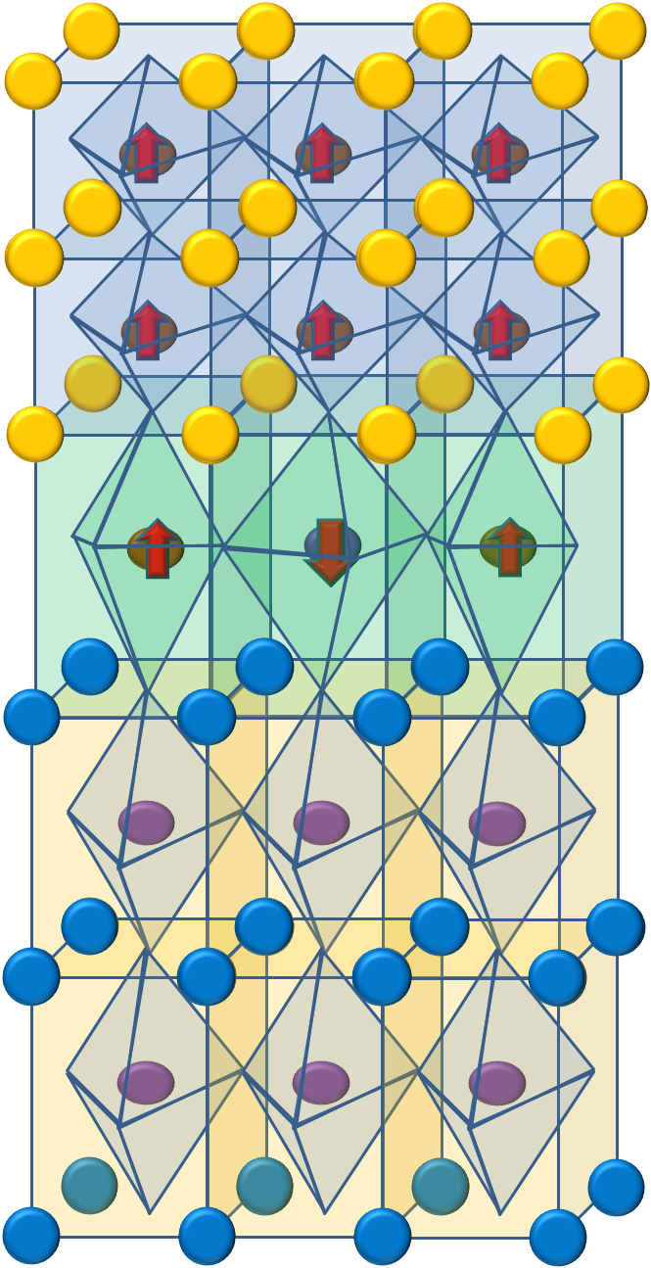
Perovskites
✪
A-site (Ca)
Oxygen
Superconductors
Ferroelectrics (BaTiO₃)
Colossal Magnetoresistance (LaSrMnO₃)
Multiferroics (BiFeO₃)
High ε_{r} Insulators (SrTiO₃)
Low ε_{r} Insulators (LaAlO₃)
Conductors (Sr₂RuO₄)
Thermoelectrics (doped SrTiO₃)
Ferromagnets (SrRuO₃)
CaTiO₃
B-site (Ti)
e_{g}
t_{2g}
Formula unit – ABO₃
A atoms at the corners
B atoms (smaller) at the body-center
O atoms at the face centers
In groups, define the crystal structure.
Notes:
In addition to being among the most abundant minerals on earth, complex oxides give some of the most varied and interesting properties. These include their use as dielectric and superconducting materials. Yet, only recently has the research in the field of complex oxides flourished because they were long thought to be …well complex. This complexity comes from the strong coupling with charge, spin, and lattice dynamics, which often results in very full phase diagrams.
Though the coupling may lead to complex behaviors, the structure of these materials can be quite simple, such as the perovskite form shown here, where the A and B sites are typically different cations and X is an anion that bonds to both. This octahedral arrangement (imagine connecting the oxygens) gives rise to a crystal field potential, hinders the free rotation of the electrons and quenches the orbital angular momentum by introducing the crystal field splitting of the d orbitals. Even among only perovskite structures, we can see these varied behaviors.

Slide 13
PEROVSKITES
A-site (Ca)
Oxygen
CaTiO₃
B-site (Ti)
Lattice: Simple Cubic (idealized structure)
1 CaTiO₃ per unit cell
Cell Basis/Motif: (see A cell diagram) Ti at (0, 0, 0); Ca at (¹/₂, ¹/₂, ¹/₂); 3 O at (¹/₂, 0, 0), (0, ¹/₂, 0), (0, 0, ¹/₂) could label differently
How many nearest neighbors?
Notes:
Yes primitive—only one lattice point per unit cell. Don’t confuse lattice points with atoms, of which there are many.
Anion doesn’t have to be oxygen, even though that is common. For example, fluorides are also of interest. Current theory suggests that the properties in fluorides might be even better than oxides.

Slide 14
PEROVSKITES
A-site (Ca)
Oxygen
CaTiO₃
B-site (Ti)
Lattice: Simple Cubic (idealized structure)
1 CaTiO₃ per unit cell
Cell Basis/Motif: (see A cell diagram) Ti at (0, 0, 0); Ca at (¹/₂, ¹/₂, ¹/₂); 3 O at (¹/₂, 0, 0), (0, ¹/₂, 0), (0, 0, ¹/₂) could label differently
How many nearest neighbors?
Ca 12-coordinate by O, Ti 6-coordinate by O, O distorted octahedral
Notes:
Yes primitive—only one lattice point per unit cell. Don’t confuse lattice points with atoms, of which there are many.
Anion doesn’t have to be oxygen, even though that is common. For example, fluorides are also of interest. Current theory suggests that the properties in fluorides might be even better than oxides.

Slide 15
PEROVSKITES
A-site (Ca)
Oxygen
CaTiO₃
B-site (Ti)
Lattice: Simple Cubic (idealized structure)
1 CaTiO₃ per unit cell
Cell Basis/Motif: (see A cell diagram) Ti at (0, 0, 0); Ca at (¹/₂, ¹/₂, ¹/₂); 3 O at (¹/₂, 0, 0), (0, ¹/₂, 0), (0, 0, ¹/₂) could label differently
How many nearest neighbors?
Ca 12-coordinate by O, Ti 6-coordinate by O, O distorted octahedral
Is this cube a primitive lattice?
Notes:
Yes primitive—only one lattice point per unit cell. Don’t confuse lattice points with atoms, of which there are many.
Anion doesn’t have to be oxygen, even though that is common. For example, fluorides are also of interest. Current theory suggests that the properties in fluorides might be even better than oxides.

Slide 16
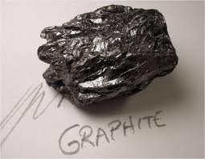
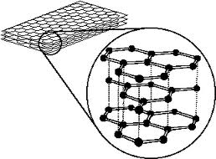
Group Exercise
How many atoms are in the primitive unit cell of graphite? Identify a unit cell.
Notes:
M1.4: Graphite = a staggered arrangement of stacked hexagonal layers
Answer: 4
Hard to see. Not one from corner on bottom and one inside, then halfway up, one from corners and one inside.

Slide 17
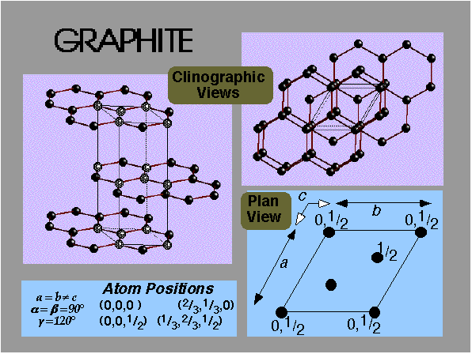
Group Exercise
How many atoms are in the primitive unit cell of graphite? Identify a unit cell.
Notes:
M1.4: Graphite = a staggered arrangement of stacked hexagonal layers
Answer: 4
Hard to see. Not one from corner on bottom and one inside, then halfway up, one from corners and one inside.

Slide 18
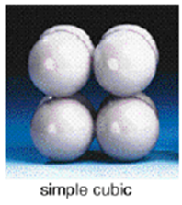
Another Reason Simple Cubic Structure is Rare
Using the spheres (like atoms) and magnetic sticks (like bonds between atoms), create a simple cubic lattice.
How does this compare to a triangular pyramid structure?
Notes:
Hard to keep cubic. Too easier tilted. Compare to triangular lattice where bonds keep it tightly in place

